Slide 1
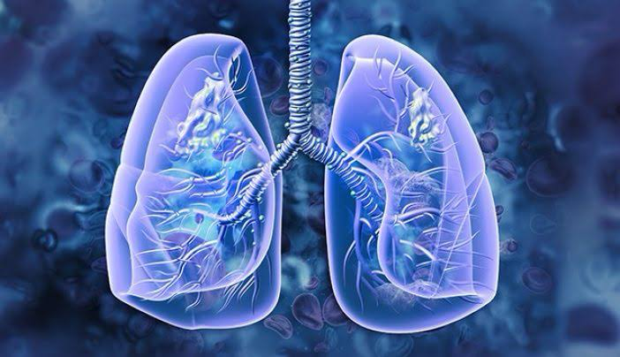
Lung cancer prediction
Lung cancer
R. Gowshika
Au412721205013
Tagore Engineering College

Slide 2
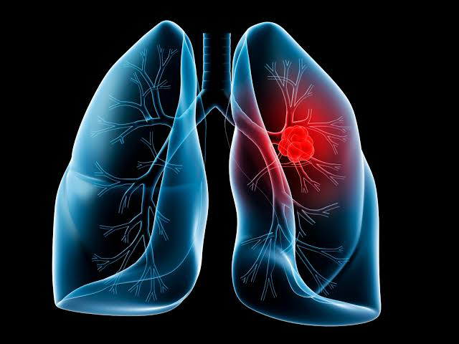
AGENDA
AGENDA
Introduction
Overview of the project goals
Data Collection
Data Preprocessing
Exploratory Data Analysis (EDA)
Correlation analysis
Model Development
ModelEvaluation
Deployment
Conclusion
Angenda

Slide 3
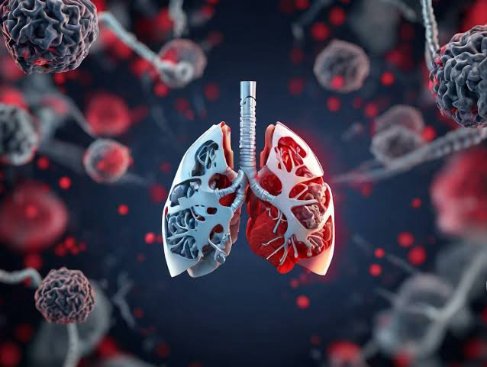
Problem statement

Slide 4

Lung cancer is one of the leading causes of cancer-related deaths worldwide, with a high mortality rate due to late-stage diagnosis. Early detection of lung cancer is crucial for improving patient outcomes and reducing mortality rates. However, current diagnostic methods such as imaging and biopsy can be invasive, expensive, and may not always detect cancer at an early stage.

Slide 5
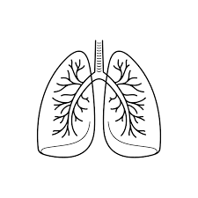
Introduction:
Brief overview of lung cancer.
Importance of research in improving diagnosis, treatment, and outcomes.
Literature Review:
Current understanding of lung cancer.
Key risk factors, including smoking, air pollution, and genetic predispositions.
Recent advancements in screening methods and early detection.
Research Objectives:
Clearly defined goals of the project, such as improving early detection, understanding treatment resistance, or identifying novel therapeutic targets.

Slide 6
Methodology: Description of research methods, including data collection (clinical trials, patient records, etc.), experimental techniques (genomic analysis, imaging studies, etc.), and statistical analysis. Results: Findings from the research, organized by specific objectives. Presentation of data, including tables, graphs, and statistical analyses. Discussion: Interpretation of results in the context of existing literature. Implications of findings for clinical practice and future research directions. Conclusion: Summary of key findings. Limitations of the study and potential areas for further investigation. References: Citations for all sources referenced in the project.
ENHANCING YOUR PRESENTATION

Slide 7
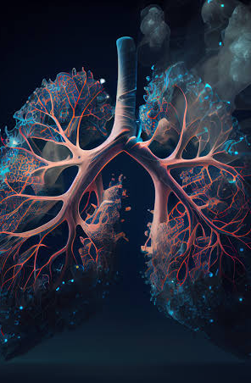
WHO IS A End users ?
The end users in lung cancer prediction can vary depending on the context and purpose of the prediction model.
They could include healthcare professionals such as oncologists, radiologists, or primary care physicians who use the predictions to guide diagnosis, treatment planning, and patient management.
Additionally, patients themselves may also be considered end users if they use the predictions to understand their risk or make decisions about their healthcare.

Slide 8
YOUR SOLUTION AND ITS VALUE PROPOSITION
Improved Diagonosis Treatment :
Predictive models can aid early detection and personalized
Treatment plans
Enhanced Survival Rates :
Accurate prediction contribute to better surviaval rates
Among lung cancer pateints
Redued Healthcare Cost :
Efficient and targeted interventions can lead to cost savings
The healthcare system

Slide 9
YOUR SOLUTION AND ITS VALUE PROPOSITION
Our ssolution employs advanced machine learning algorithms to predict lung cancer
with high accuracy
by leveraging cutting-edge technology,we aim to provide early detection and improve
treatment outcomes
With our platform,patients and healthcare providers can make informed decisions for
personalized care

Slide 10
MODELLING
Data Collectiion
Gathering revelavant medical records,imaging data,and patients
histories
Feature selection
Identifng the most predictive variables and characteristics
Algorithm Selection
Choosing the appropriate machine learning algorithm for prediction

Slide 11
RESULT
Afte analyszing the data and traning the predictive model,the testing phase
confirmed an Accuracy of 85% In predicting lung cancer in early stages.
The model also demonstrate a specificity of 91% and a sensitivity of 82%,
indicating its potential for accurate predictions
ACCURACY
85%
Percent of correct predictions

Slide 12
Thankyou!!

